Slide 1
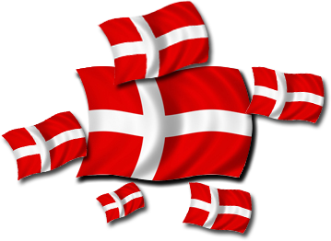
Famous people from Denmark

Slide 2
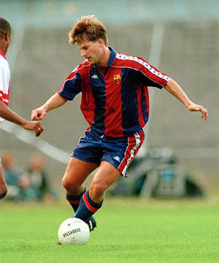
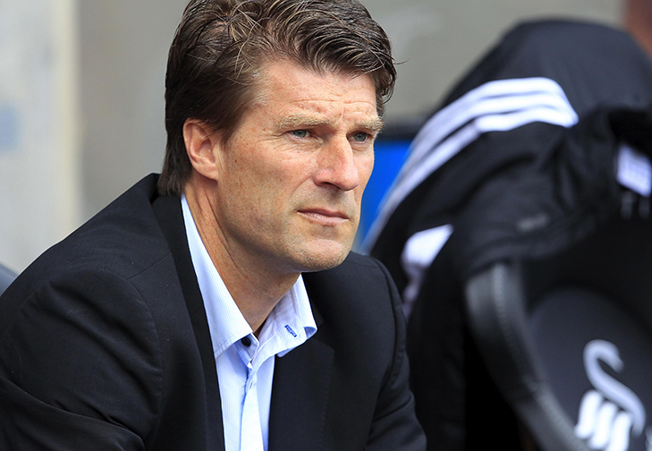
Michael Laudrup
Click to see more

Slide 3
Michael Laudrup has played in:
Brøndby (1982 – 1983)
Juventus (1983 – 1989)
Lazio (rentet from 1983 – 1985)
FC Barcelona (1989 – 1994)
Real Madrid (1994 – 1996)
Vissel Kobe (1996 – 1997)
Ajax (1997 – 1998)
He has played 104 matches for the national team in Denmark
He has worked as a trainer in: assistent trainer for the nationale team in Denmark (2000 – 2002), Brøndby IF (2002 – 2006), Getafe (2007 – 2008), Spartak Moskva (2008 – 2009), Mallorca (2010 – 2011), Swansea City (2012 – 2014), Lekhwiya (2014 - )

Slide 4
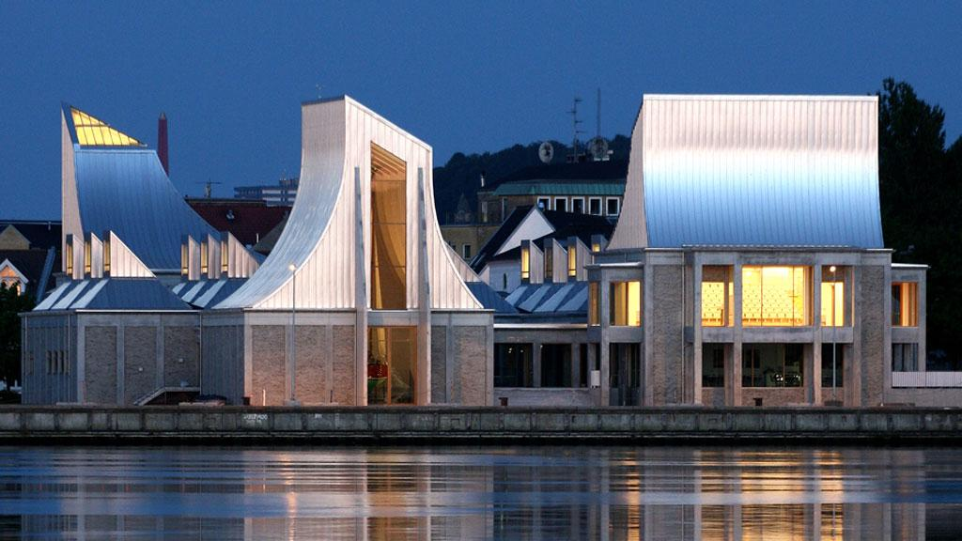
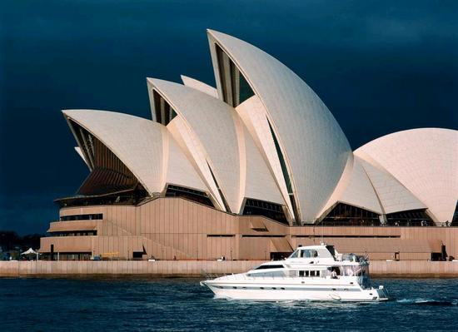
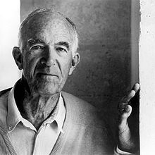
Jørn Utzon
- a Danish architect
Click to see more
Utzon Center Aalborg
The Sydney Opera House

Slide 5
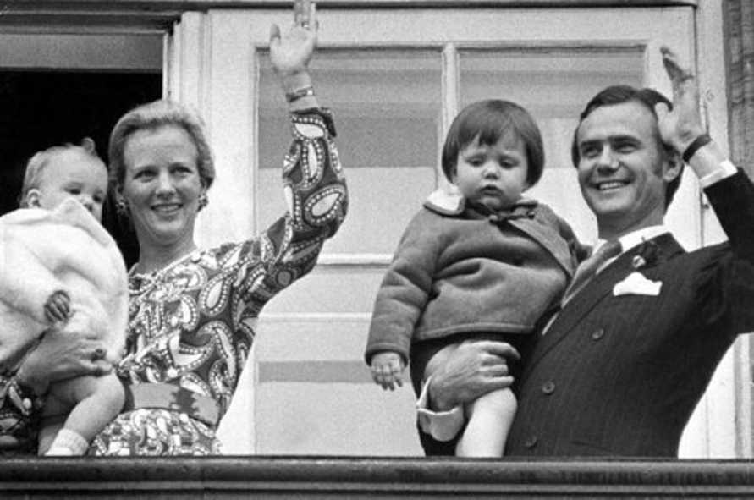
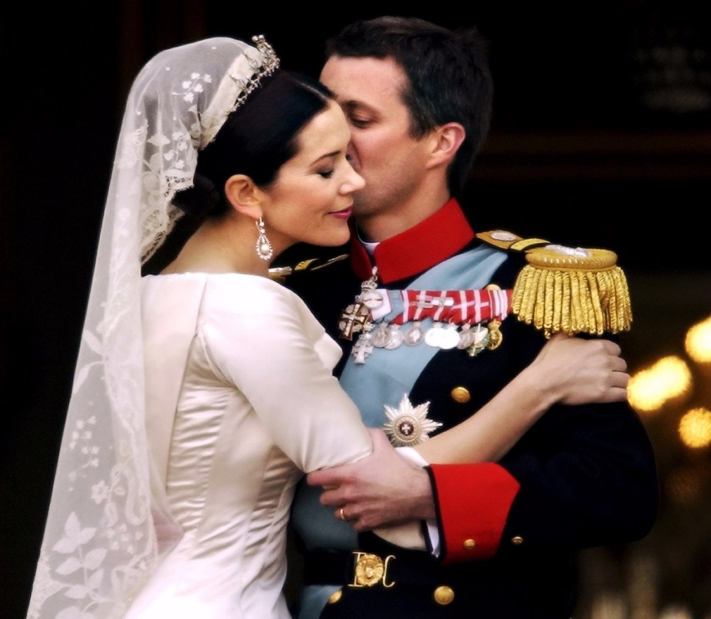
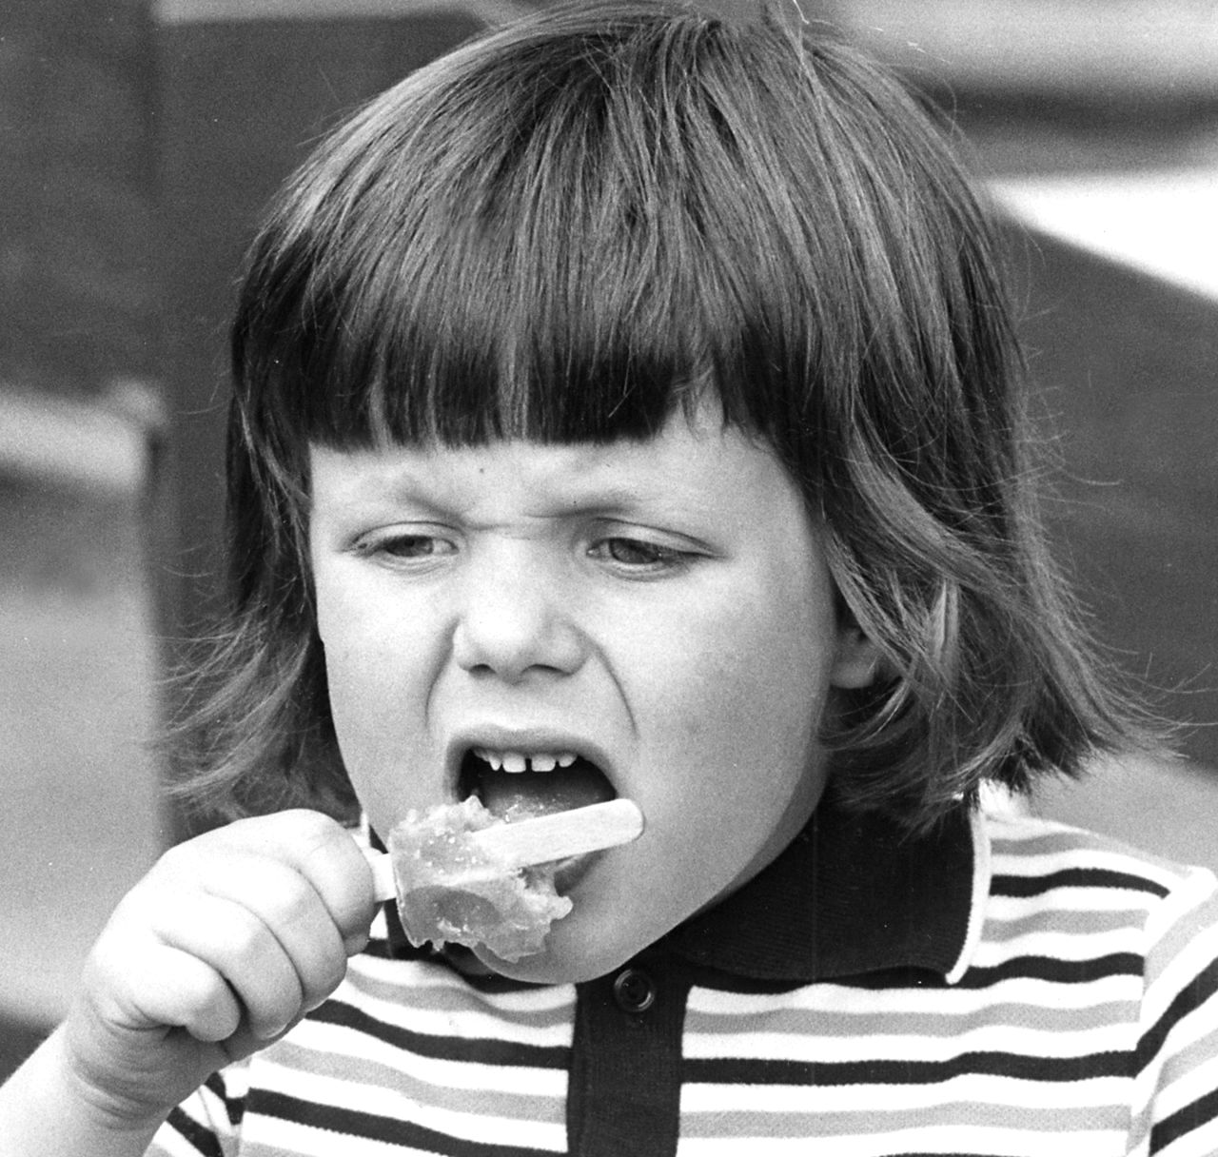
The Danish Crown prince Frederik

Slide 6
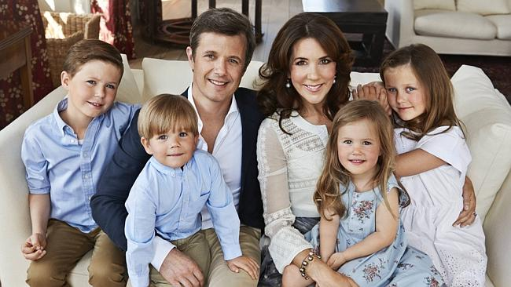
Click….
Crown prince Frederik and his familie. His wife Mary comes from Australia and they have four kids together.

Slide 7
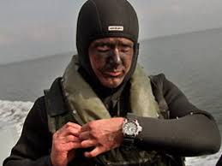
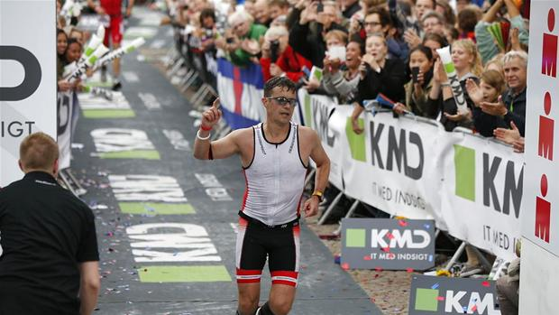
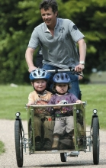
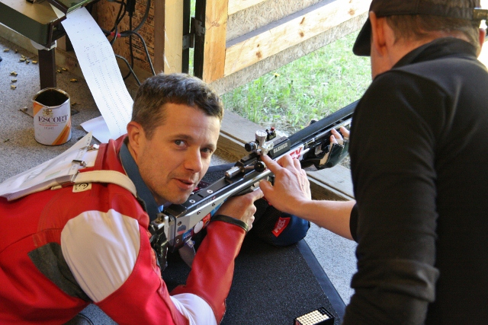
A prince with many hobbies and jobs.

Slide 8
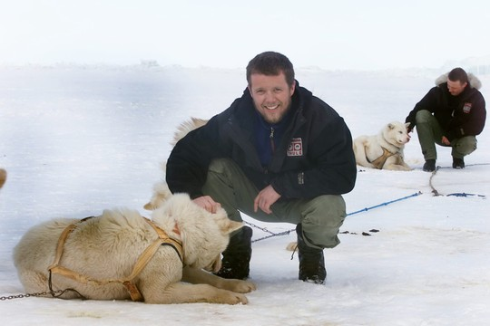
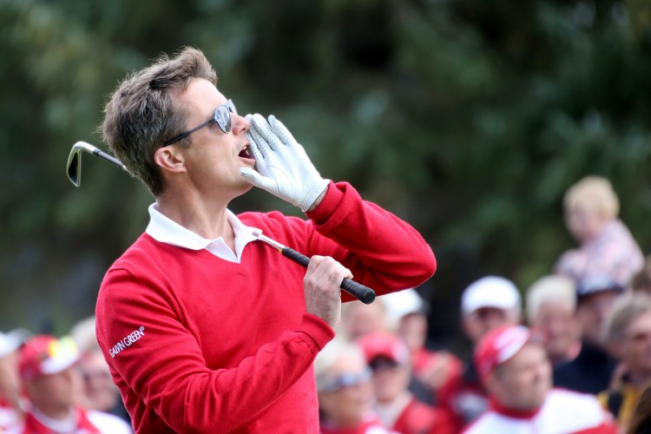
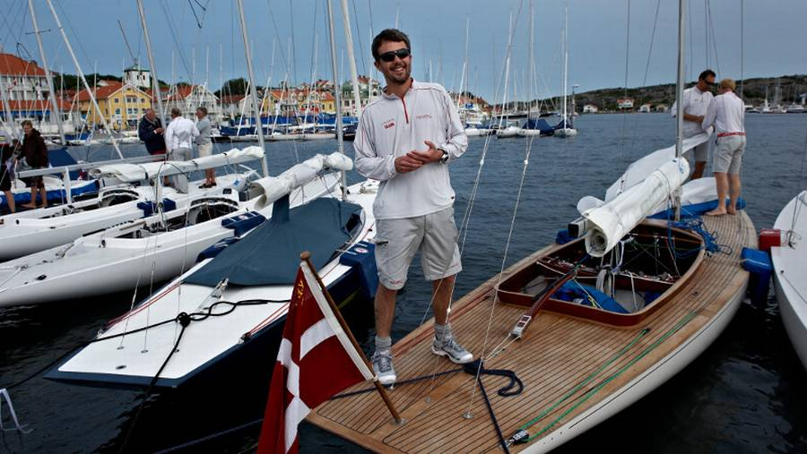
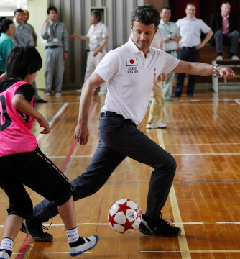
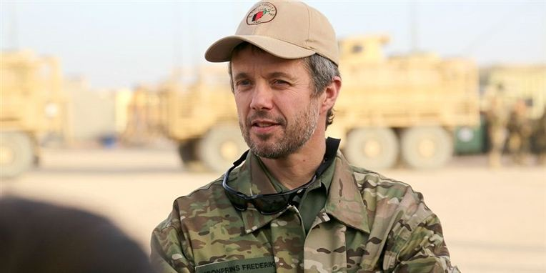

Slide 9
Tom Kristensen

Slide 10
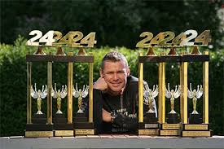
Facts: Tom Kristensen
Racedriver
Birth: 07.07.1967
Born: Hobro, Danmark
Height: 1,74
Weight: 72 kg
City: Hobro, Danmark
Hobbies: Cycling, Ski, Golf & Squash
9-times 24 Heures du Mans-winner (1997, 2000-2005, 2008, 2013) – Record
6- times Sebring 12 Hours-winner (1999, 2000, 2005, 2006, 2009, 2012) - Record
FIA World Endurance Champion 2013
American Le Mans Series Champion (2002)
German Formula 3 Champion (1991)
Japanese Formula 3 Champion (1993)
Motorsport's Hall of Fame 2013
DTM driver Audi Abt Sportsline (2004-2009), 4 victories
http://www.motorsporten.dk/profil.asp?i=85

Slide 11
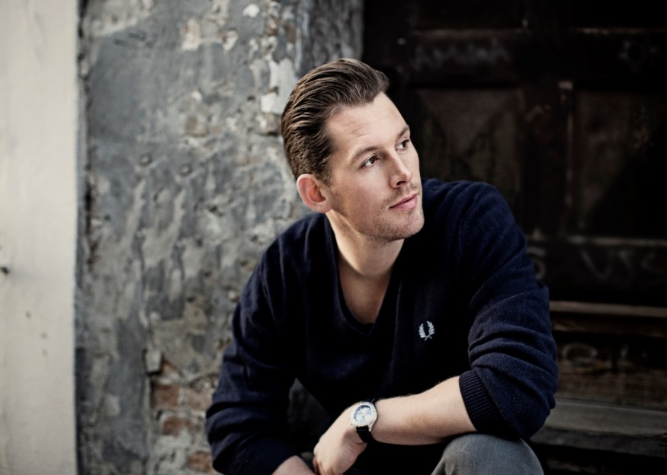
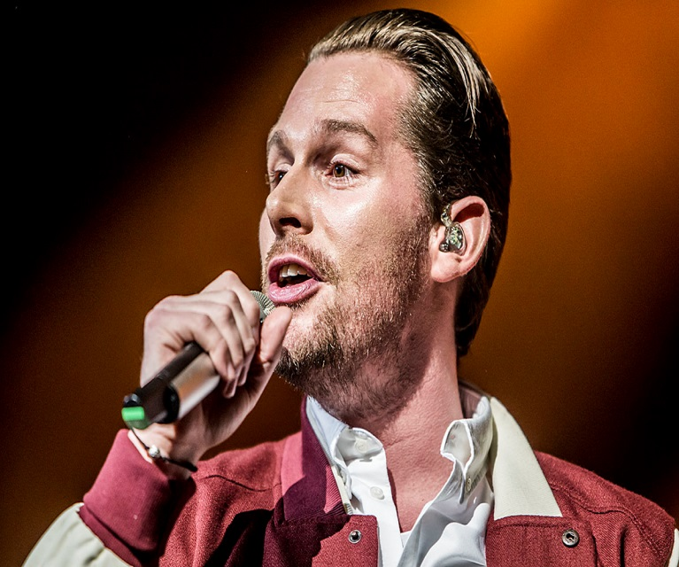
Rasmus Seebach
Listen to this…

Slide 12
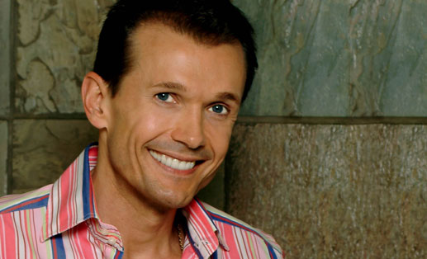
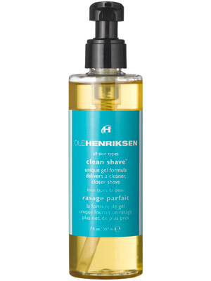
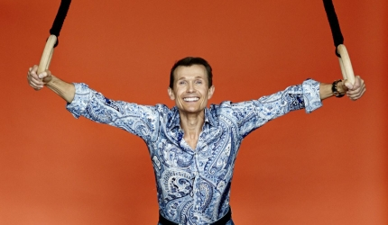
”I Love it!!!! ☺ ☺ ☺
Click…
Ole Henriksen
”The queen of beauty”

Slide 13
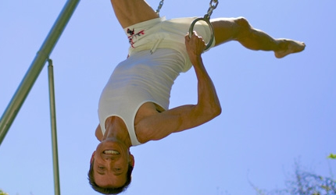
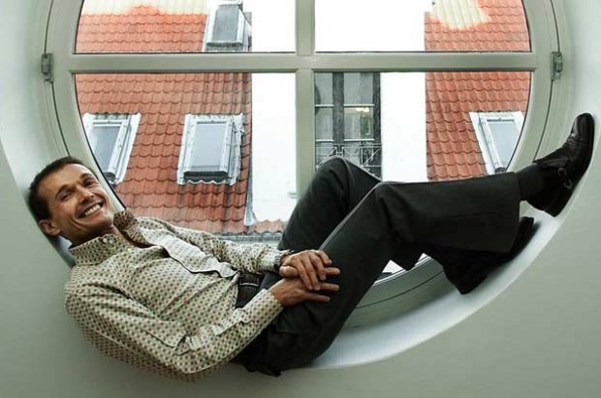
Click here..
Click to see more..

Slide 14
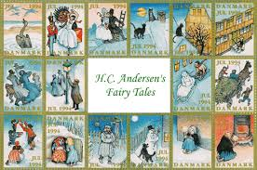
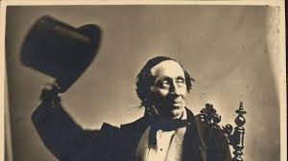
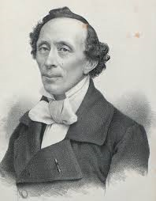
H.C. Andersen
World famous for his fairy tales.
The Ugly Duckling

Slide 15
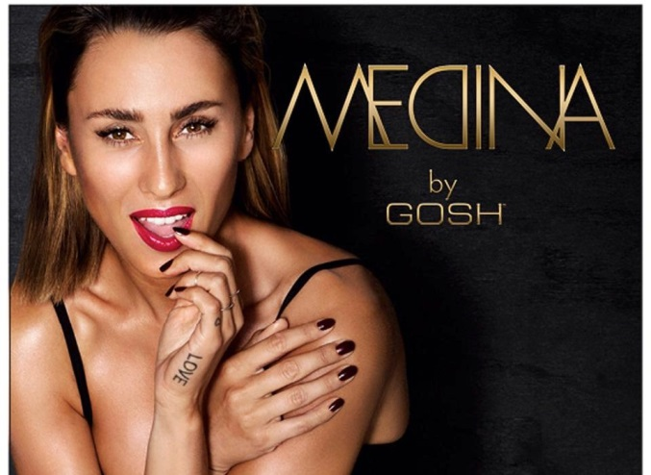
Medina
Click and Listen to my music.

