Slide 1
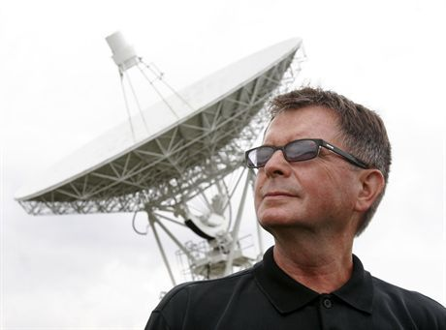
Aleksander Wolszczan.
Polish radioastronomer , academic teacher, co-discoverer of the first extrasolar planets, professor at university in Pensylvania, received his PhD at Nicolaus Copernicus University in Toruń.

Slide 2
Childhood and youth
Aleksander Wolszczan has been interedted in stars since his childhood. He said that he was inspired by his father who was telling him various history about constellation ,for exemple Greek, Rome and China legends. When he was 7 years old he arleady knew base knowledge about astronomy. He observed the moons of Jupiter from the attic of his house. He used a telescope made by himself. As a student of secondary school he won an astronomy contest.
After he had graduated from high school he came to Toruń to study stronomy.During his studying he worked as a technology intern. He finished college in 1969. In 1973 as an senior assistant he came to Max-Planck-Institute of Radioastronomie w Bonn , which disposed of radiotelescope Effelsberg. In 1975 he got PhD.
dzi

Slide 3
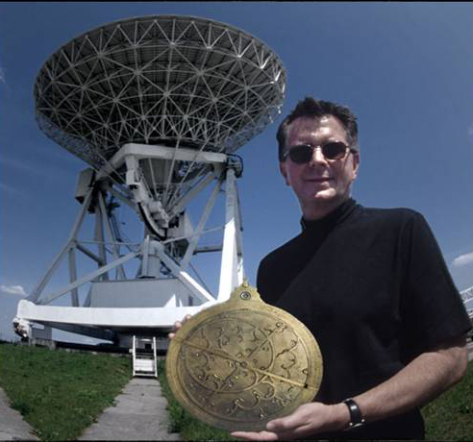
From the begining of martial law in Poland he came out to Bonn again where he received a lot of propositions to work in American agencies. He decided to departure to Cornell University– university which had the biggest radiotelescope in the world. It is near Arecibo , on Portoryko island. In 1990 he obtained opportunity to take advantage of radiotelescope to implemen his own research project.

Slide 4
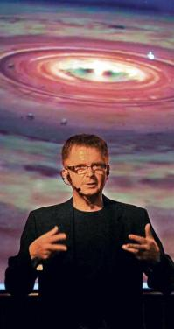
In 1991 in Arecibo observatory Aleksander Wolszczan identifed pulsar PSR B1257+12. Then he transpired that the pulsar has got at least three moons are circulating around the planet. It was the first extrasolar planet recognise by a human being. Next observations allowed to ascertain that in fact around PSR 1257+12 four moons are circulating. This discover was paraded in official in 1992 on American Company of Astronomy in Atlanta and also in "Nature„ magazine. The results of his researches were publiced by Wolszczan in 1994 in „Science„ magazine.

Slide 5
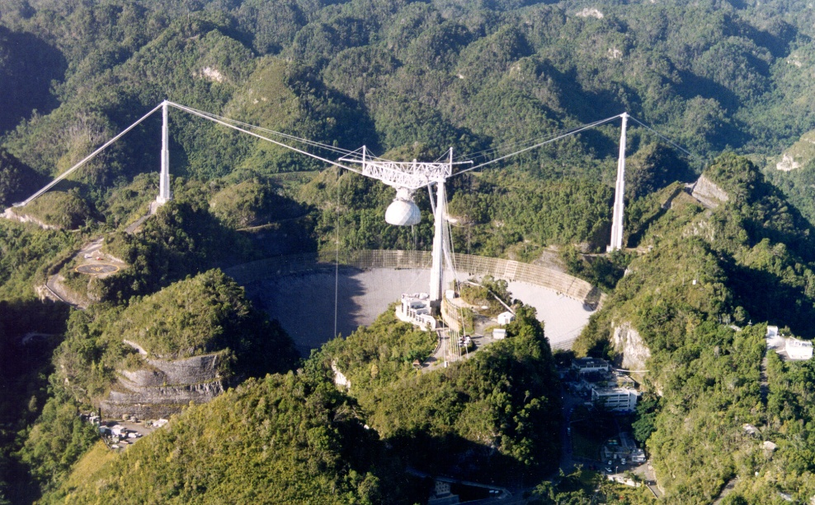
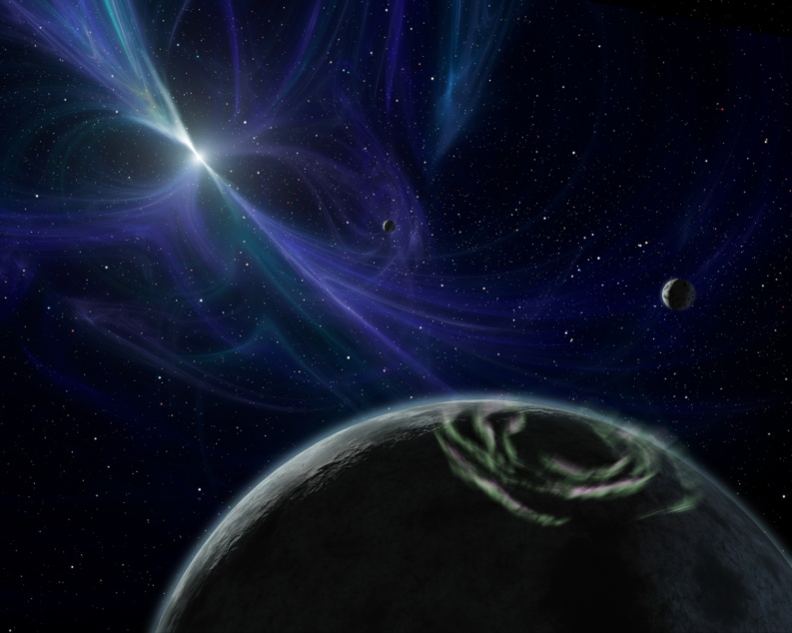
Since 1922 Aleksander Wolszczan has been conducting research at State Univesity in Pensylvania. From his initative, Physical Institute in Szczecin University, Department of Astronomy and Astrophysics was established.
Arecibo
PSR 1257+12

