Slide 1
Maria Skłodowska Curie

Slide 2
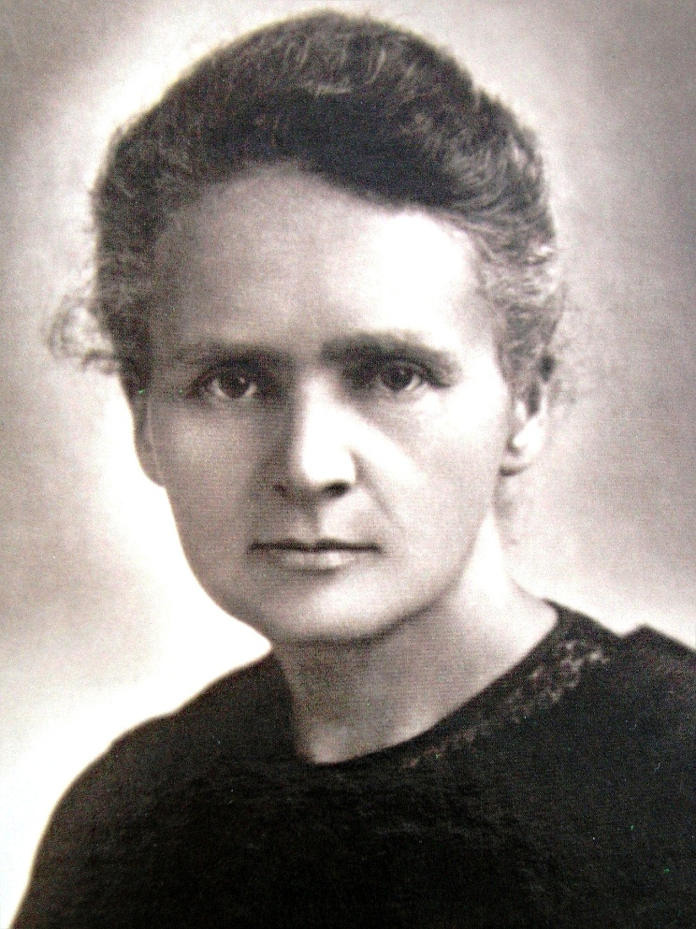
Maria Skłodowska Curie
She was born on
7 November 1867 in Warsaw, and died on 4 July 1934 in Passy in France. She was a chemist and physicist. Twice Nobel price. Became famous the discover Radium and Polonium.

Slide 3
Maria was born in Warsaw as fifth and last child in known family teaching. Father Władysław Skłodowski was mathematics and physicist. When Maria was 9 years, oldest sister Zofia die on typhoid, on turn 2 yers later when Maria was 11 yers die her mother, which years ill on tuberculosis.
Then educated in female governmet secondary school, which completed in 1883 years with gold medal. After returning to Warsaw gave tutoring of mathematics,physics and foreign languages. She knew: Polish,Russian,German,englisch and French.

Slide 4
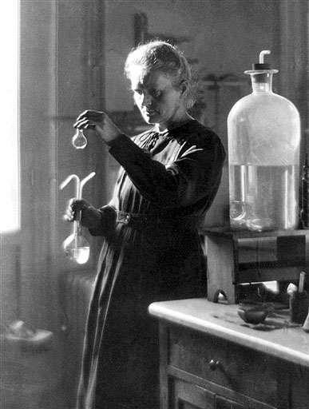
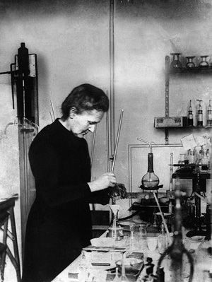
The end year 1897 Maria Skłodowska Curie seeking subject to hearing to obtain the deegre of doctor taken first research with rays Becquerel. Maria taking scientific work the radiation discovered by Becquerela applied instead photographic film very sensitive electrometer.

Slide 5
Thanks for watching
Kamil Czermak IGA

