Slide 1
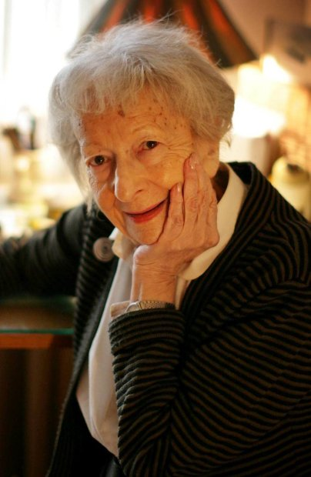
Wisława Szymborska
Polish poet
who explored philosophical, moral, and ethical issues with intelligence and empathy.

Slide 2
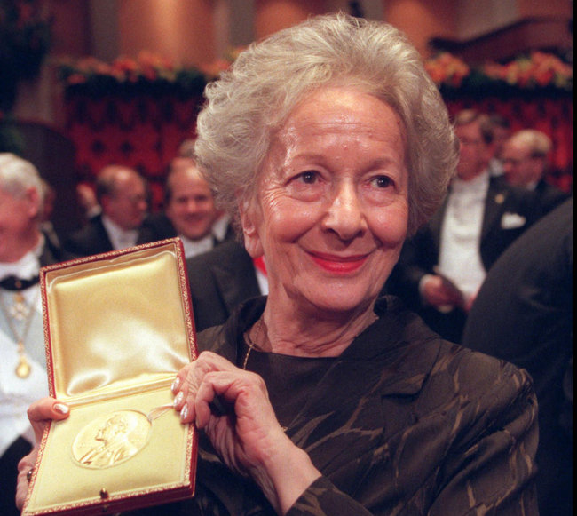
Wisława SzymborskA
In 1996 she received the Nobel Prize for Literature.
Her work has been translated into English and many European languages, as well as into Arabic, Hebrew, Japanese and Chinese.

Slide 3
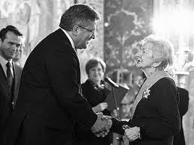
Wisława SzymborskA
Prizes and Awards
1954: The City of Kraków Prize for Literature
1963: The Polish Ministry of Culture Prize
1991: The Goethe Prize
1995: The Herder Prize
1995: Honorary Doctor of the Adam Mickiewicz University (Poznań)
1996: The Polish PEN Club prize
1996: Nobel Prize for Literature
2011: Order of the White Eagle

Slide 4
Wisława SzymborskA
Szymborska was born on 2 July 1923 in Prowent. She later moved to Kraków in 1931 and studied literature and sociology at the Jagiellonian University there between 1945 and 1948. Her first published poem, “Szukam słowa” (“I Seek the Word”), appeared in a Kraków newspaper in March 1945. Her first volume of poetry, Dlatego żyjemy (1952; “That's Why We Are Alive”), was an attempt to conform to Socialist Realism, the officially approved literary style of Poland's communist regime. In 1953 she joined the editorial staff of Życie Literackie (“Literary Life”), a weekly magazine of intellectual interests, and remained there until 1981. During this period she gained a reputation not only as a poet but also as a book reviewer and translator of French poetry. In the 1980s she wrote for the underground press under the pseudonym Stancykówna and for a magazine in Paris. Wisława Szymborska died 1 February 2012 at home in Kraków, aged 88.

Slide 5
Wisława SzymborskA
Cat in an Empty Apartment
Die—you can’t do that to a cat.
Since what can a cat do
in an empty apartment?
Climb the walls?
Rub up against the furniture?
Nothing seems different here
but nothing is the same.
Nothing’s been moved
but there’s more space.
And at nighttime no lamps are lit.
Footsteps on the staircase,
but they’re new ones.
The hand that puts fish on the saucer
has changed, too.
Something doesn’t start
at its usual time.
Something doesn’t happen
as it should.
Someone was always, always here,
then suddenly disappeared
and stubbornly stays disappeared.
Every closet’s been examined.
Every shelf has been explored.
Excavations under the carpet turned up nothing.
A commandment was even broken:
papers scattered everywhere.
What remains to be done.
Just sleep and wait.
Just wait till he turns up,
just let him show his face.
Will he ever get a lesson
on what not to do to a cat.
Sidle toward him
as if unwilling
and ever so slow
on visibly offended paws,
and no leaps or squeals at least to start.

