Slide 1
Presentation: some famous people from Poland.

Slide 2
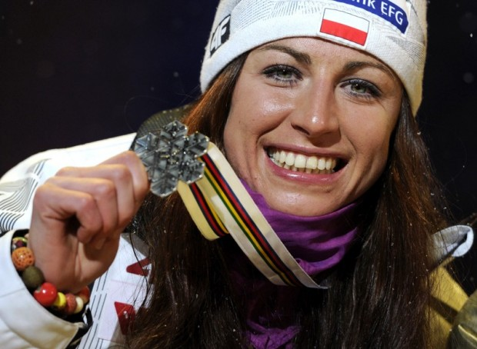
Justyna Kowalczyk
Justyna Kowalczyk is a polish cross country skier. She’s very popular, not only in Poland. Justyna has been competiting since 2001 and over these years she has won the titles inter alia of double Olymphic Champion and double World Champion. She was born in 1983, in Limanowa – small, polish town. Justyna is 31 years old. Her height is 1.73m and she’s well-built woman.

Slide 3
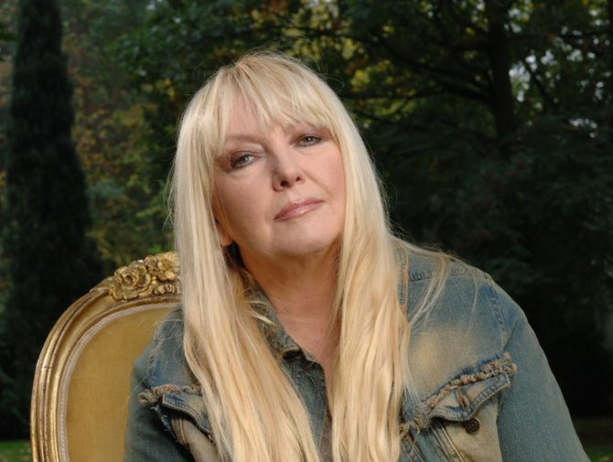
Maryla Rodowicz
Maryla Rodowicz was born as Maria Antonina Rodowicz in 1945, in Zielona Góra. She’s been a Polish singer since 1967. Rodowicz is also an actress. Maryla is 68 years old, and she’s still popular – in special events in the year she sings in colourful costumes. I think she’s an energetic and creative person. The singer has a lot of fans.

Slide 4
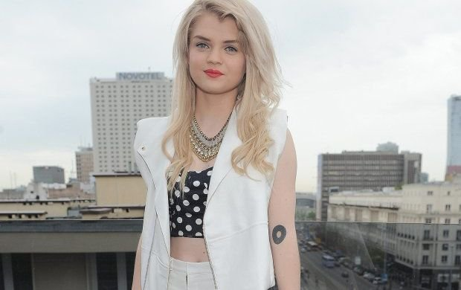
Margaret
Małgorzata Jamroży – known by her stage name Margaret, was born on June 30, 1991. She’s a young Polish singer and fashion blogger. Her first debiut single ’Thank You Very Much’ made her very popular in Europe. She has a lot of Italian, Polish and German fans. Margaret is a really talented singer. She loves music and she can also play saxophone. Małgorzata makes pop music and her fans are waiting for something as big and new as ’Thank You Very Much’!

