Slide 1
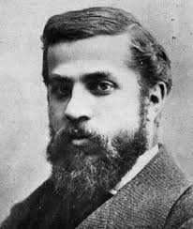
ANTONI GAUDÍ
1852 – 1926
Barcelona
The most well known architect in Catalonia.
He’s a Modernist artist.
He built La Sagrada Familia and La Pedrera.
He died run down by a passing tram.

Slide 2
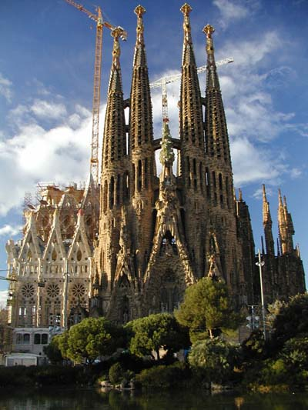
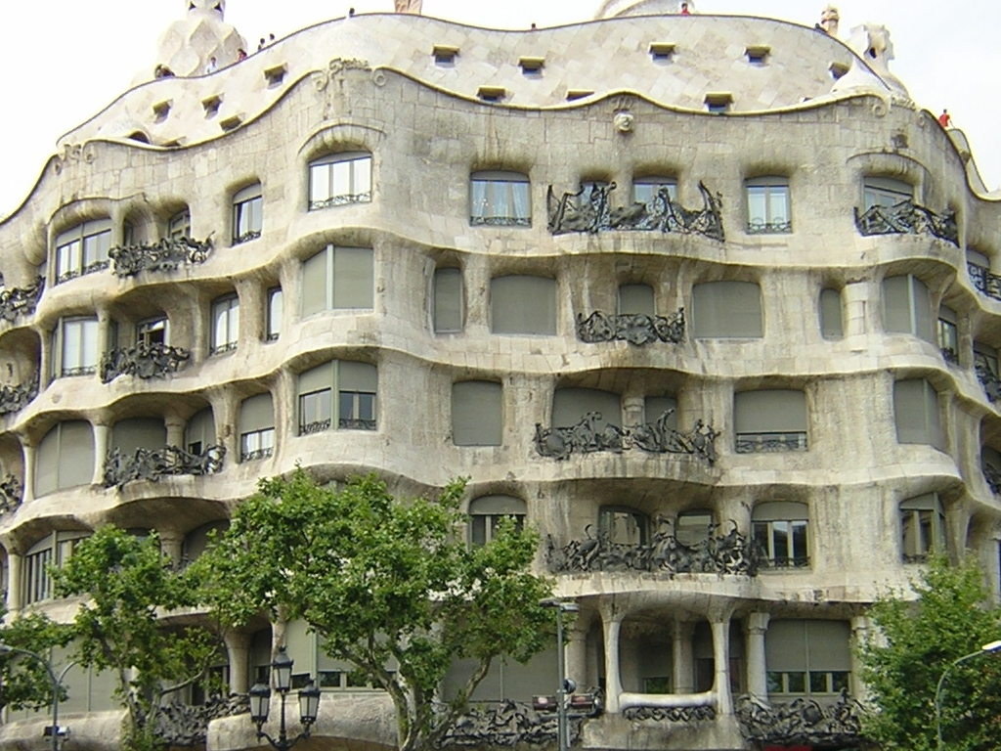
LA SAGRADA FAMILIA LA PEDRERA

Slide 3
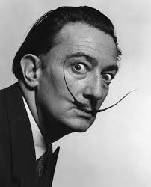
SALVADOR DALÍ
1904 – 1989
Girona
The best painter of Catalonia.
He created striking and original paintings.
His pictures are surrealist.

Slide 4
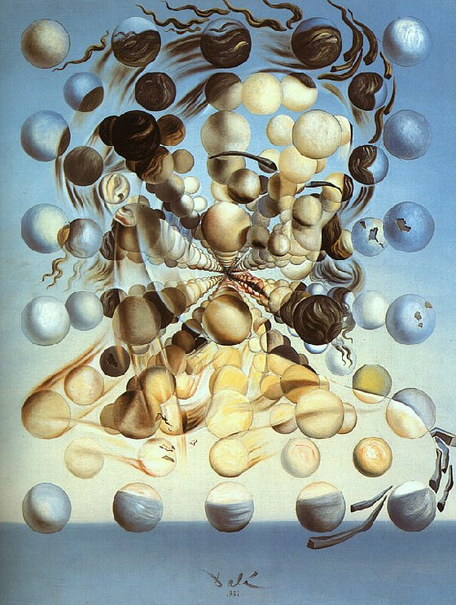
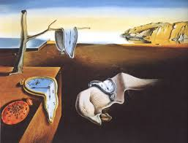
Most important paintings:
Galatea of the Spheres The persistence of the memory

Slide 5
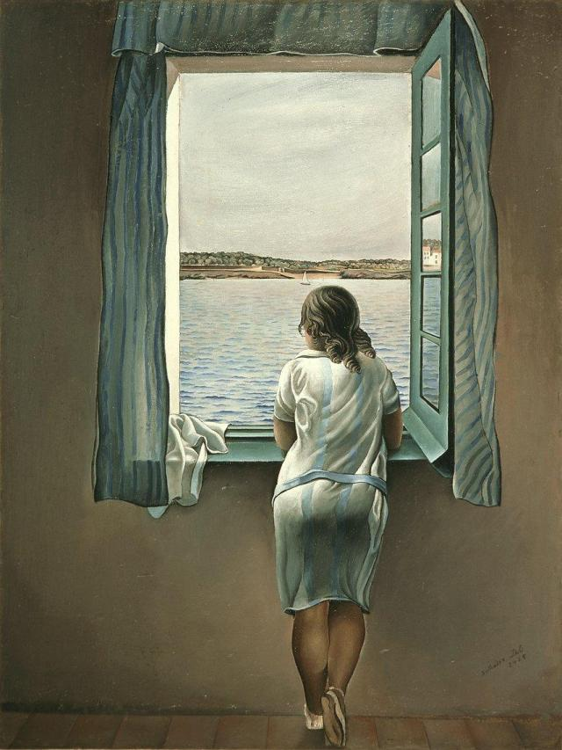
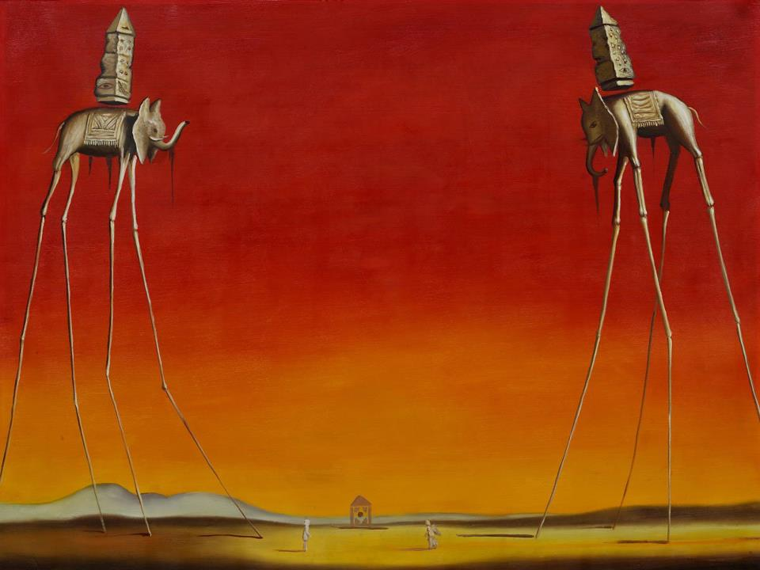
Most important paintings:
Girl at the window Elephants

Slide 6
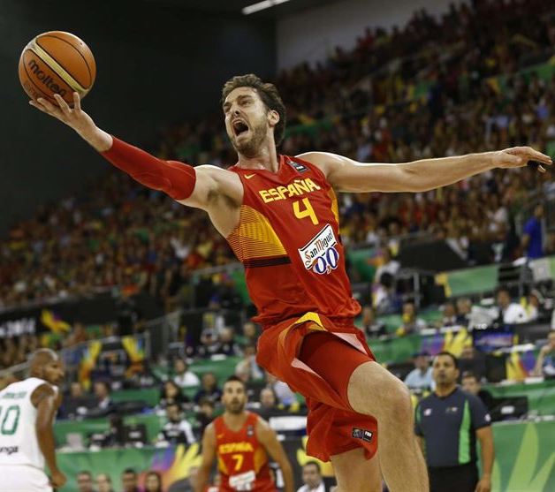
PAU GASOL
1980-
Barcelona.
Basketball player.
Second Spanish player to play in NBA.
Currently playing for Chicago Bulls (NBA).
Gold medal at the 2006 FIFA
World Championship (in Japan).

Slide 7
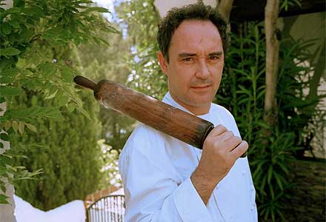
Ferran adrià
1962-
Barcelona.
Best chef in Catalonian and one of the best chefs in the world.
Restaurant “El Bulli” (Girona).
Creative cuisine.
He currently runs a cooking school

Slide 8
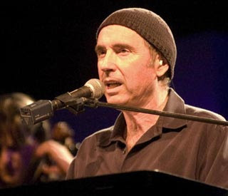
Lluís llach
1957 Girona.
Musician, song writer.
He’s one of the main representatives of the Catalan New Song (Nova Cançó).
He left Catalonian and lived in Paris until the death of the dictator, Franco.
His most representative song is “L’estaca” (The Stick).

Slide 9
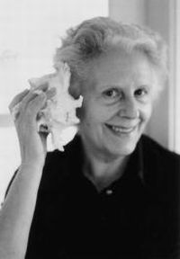
MERCÈ RODOREDA
1908 – 1983 Barcelona
Writer.
Books: “The diamond square”, translated as “The Time of the Doves”, “Aloma”, “Broken Mirror”.
She won many awards, among them the most prestigious Catalan literary prize “El premi d’Honor de les Lletres Catalanes”.
Her work has been translated into 30 different languages.

